Slide 1

Utilitarianism Theory of Business Ethics
Utilitarianism, at its core, seeks to maximize overall well-being while minimizing harm. This presentation explores how this ethical framework applies to business decisions, aiming for the greatest good for the greatest number.

Slide 2
Understanding Utilitarianism
Consequentialism
Moral Action
Ethical decisions are based on outcomes, emphasizing the consequences of actions.
The moral action is the one that produces the most overall good.
Defining "Good"
Impartiality
"Good" is often equated with happiness, pleasure, or overall welfare.
Everyone's happiness counts equally, ensuring fair consideration.

Slide 3
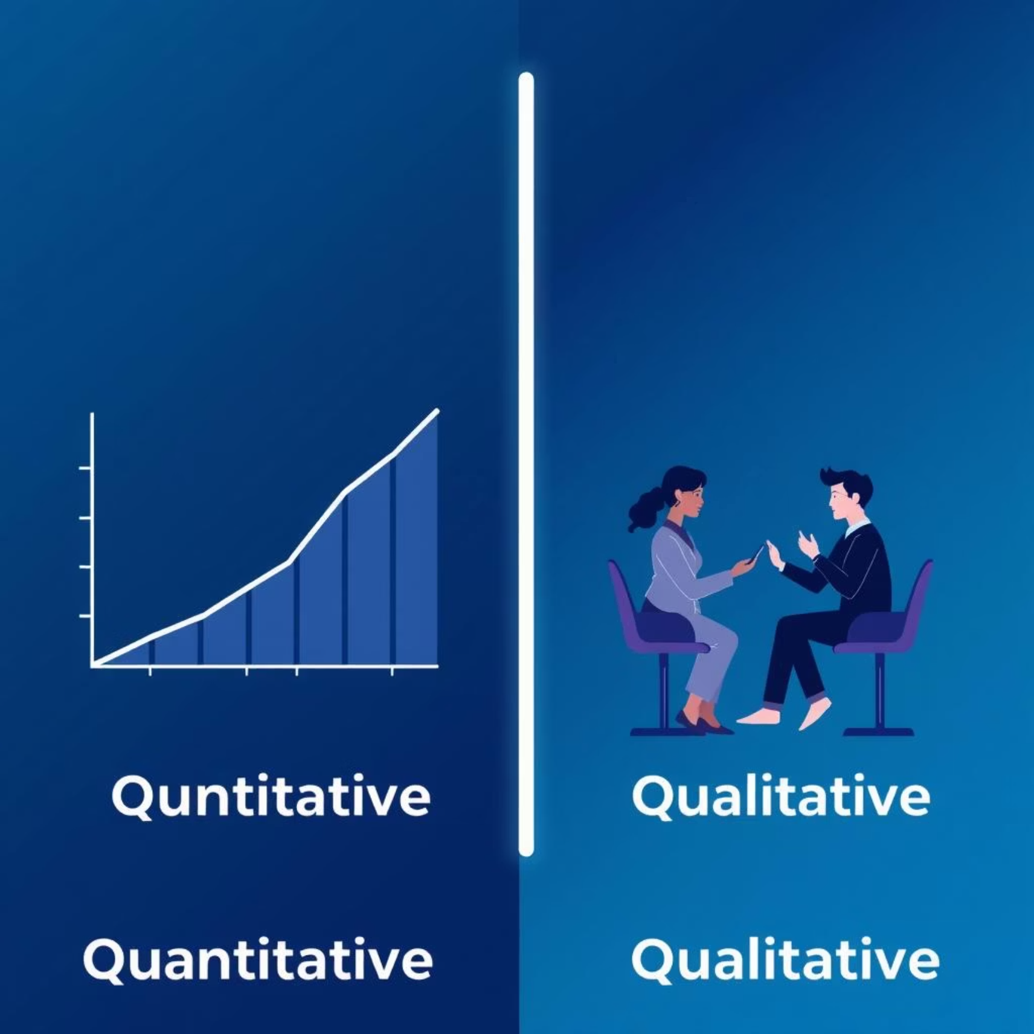
Key Principles and Types
Act Utilitarianism
Quantitative vs. Qualitative Utility (Bentham vs. Mill)
Focus on net aggregate benefit, not individual gain.
Evaluates the consequences of each individual action.
Rule Utilitarianism
Adheres to rules that generally maximize utility.

Slide 4




Application in Business Decisions
Resource Allocation
Product Safety
Investing in projects with the broadest societal benefit.
Balancing safety standards with production costs and accessibility.
Environmental Impact
Stakeholder Focus
Policies minimizing harm to ecosystems and communities.
Prioritizing outcomes for all stakeholders.

Slide 5

Case Study: Sustainable Sourcing Initiative
Scenario
A global apparel company considers switching to 100% sustainable materials.
Data
Initial cost increase of 15% ($25M)
Reducing short-term profit by 2%
Impact
Benefits 500,000 farmers annually
Benefits 15M consumers (healthier products)
Reduces carbon footprint by 30%
Outcome
Decision made: net positive utility for vast majority.

Slide 6
Criticisms and Challenges
Minority Rights
Predicting Outcomes
Can sacrifice individual rights for the benefit of the majority.
It's difficult to accurately foresee all consequences of decisions.
Measuring Utility
Justice Issues
"Happiness" or "good" is subjective and hard to quantify precisely.
May justify unfair distribution if the aggregate good is high.

Slide 7
Ethical Dilemma: Plant Closure Decision
Scenario
Plant B
Company must close one plant to ensure overall survival.
200 employees
High wages
Plant A
Diverse local economy
500 employees
Utilitarian Analysis
Low wages
Closing Plant B minimizes total job loss and community impact, despite higher individual impact for fewer.
High local unemployment

Slide 8



Balancing with Other Ethical Theories
Deontology
Virtue Ethics
Rights-Based Ethics
Focus on duties/rules, complementing utilitarian outcomes.
Emphasizes character and moral virtues guiding decisions.
Ensures protection of fundamental individual rights.
A holistic approach is often necessary for complex business ethics.

Slide 9




Implementing Utilitarian Principles
Cost-Benefit Analysis
Stakeholder Mapping
Extend beyond financial aspects to include social and environmental factors.
Identify all affected parties and quantify their impact.
Transparency
Long-Term View
Openly communicate the rationale behind decisions.
Consider long-term societal and environmental consequences.

Slide 10
Conclusion: Ethical Leadership for the Greater Good
Utilitarianism offers a framework for maximizing positive impact.
It requires considering all consequences and stakeholders.
It's essential for responsible corporate citizenship in a globalized world.
Focus on sustainable, equitable, and beneficial outcomes for society as a whole.

