Slide 1

The Ethical Theory of Rights and Duties
This presentation explores the foundational concepts of rights and duties in shaping moral societies. We will delve into the interconnectedness of entitlements and obligations, highlighting their historical evolution and contemporary applications. A significant 85% of global constitutions include human rights provisions, underscoring their universal importance.

Slide 2
Defining Rights: Legitimate Entitlements
Definition
Origin
Example
Moral or legal claims/entitlements recognized within a society.
Derived from natural law, social contracts, and principles of human dignity.
Article 3, UDHR: "Everyone has the right to life, liberty and security of person."
John Locke, in 1689, articulated fundamental rights as "life, liberty, and property," significantly influencing modern concepts of rights.

Slide 3



Defining Duties: Moral Obligations
Definition
Origin
Example
A moral or legal obligation; a responsibility to act in accordance with principles.
Reciprocal to rights, arising from societal roles and fundamental moral principles.
The duty not to infringe upon another's right to life or freedom.
Immanuel Kant, in 1785, grounded moral duties in the Categorical Imperative, emphasizing universal moral laws.

Slide 4
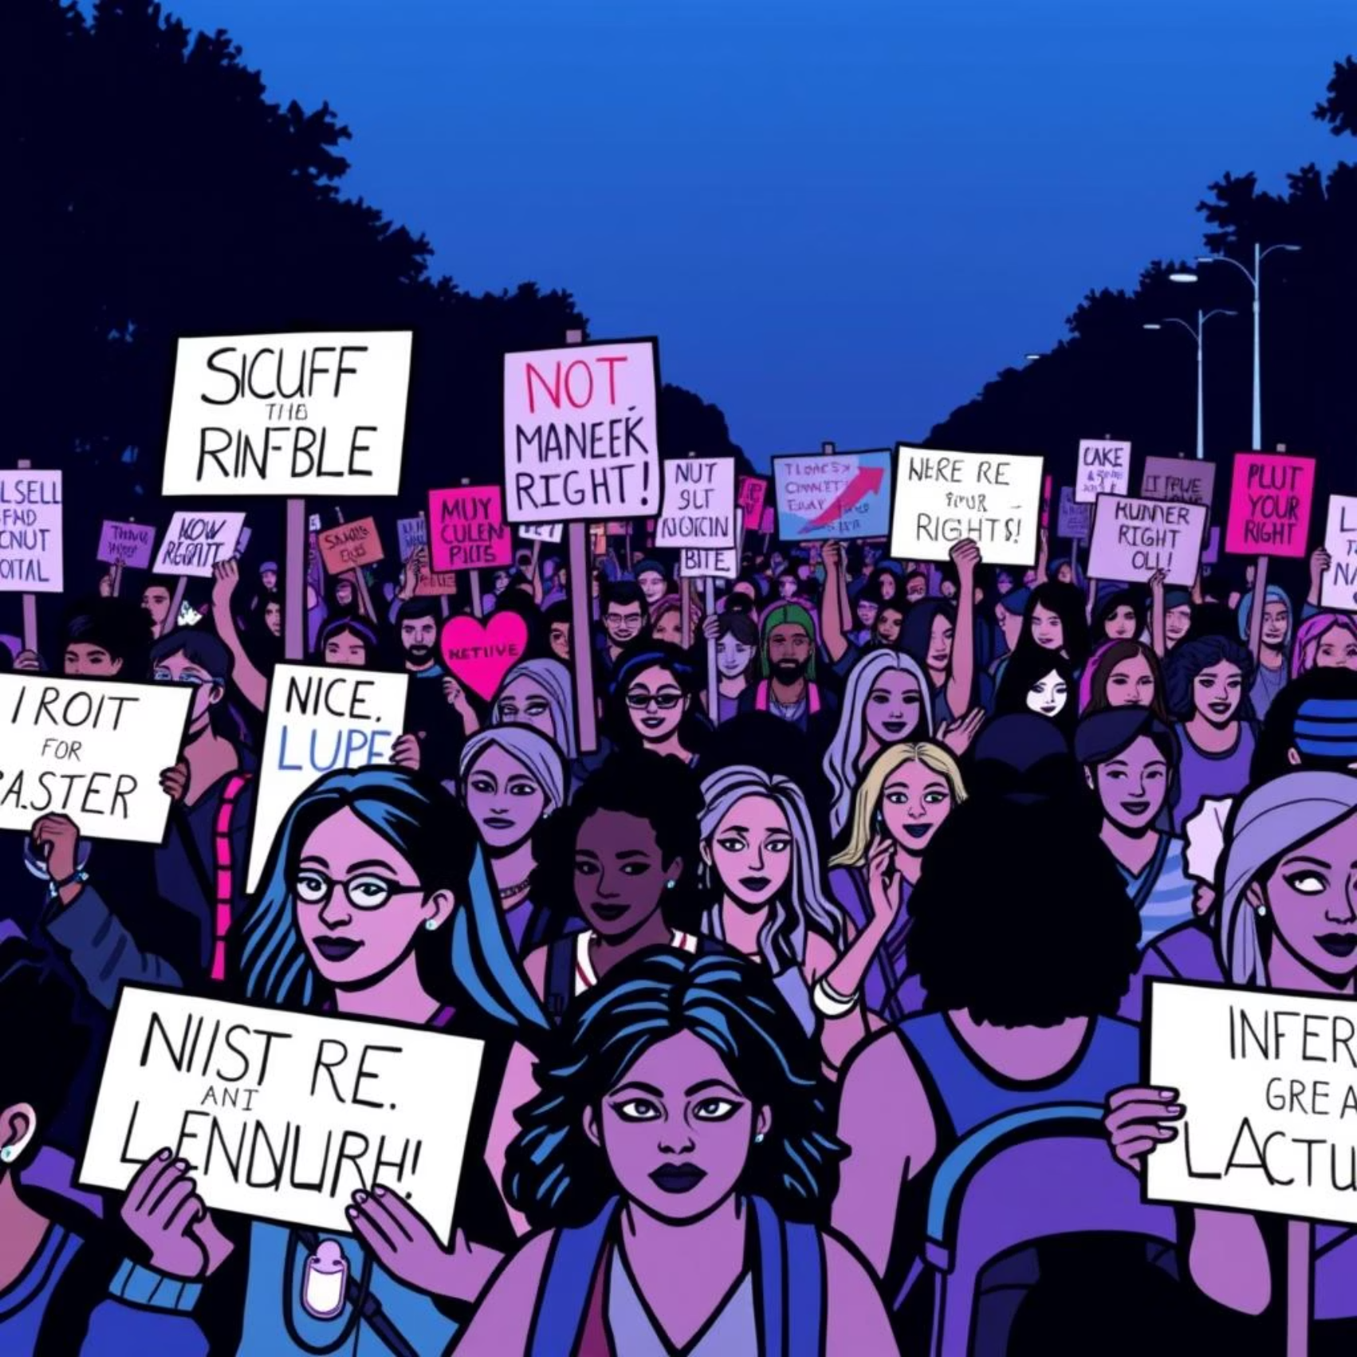
Categories of Rights
Negative Rights: Freedom *from* interference
(e.g., speech, religion)
Positive Rights: Entitlement *to* something
(e.g., education, healthcare)
Civil/Political: Vote, assembly
Economic/Social/Cultural: Work, housing
The International Covenant on Civil and Political Rights (1966) further elaborates these categories.

Slide 5
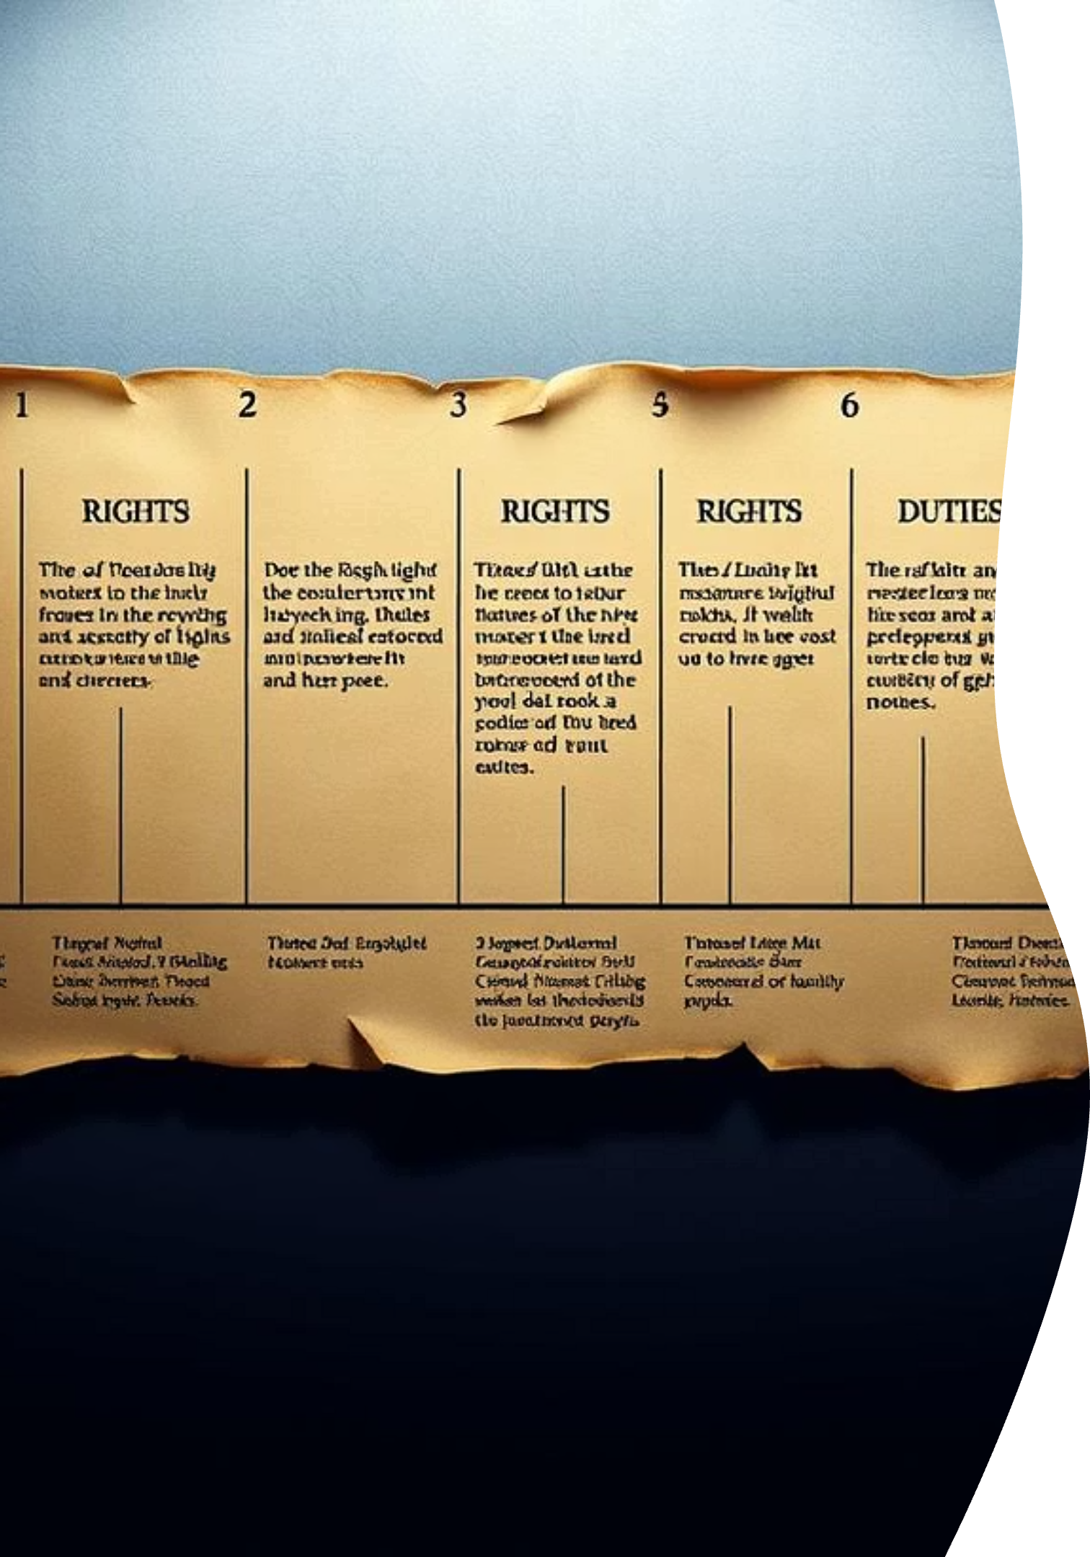
Historical Evolution of Rights & Duties
1
Ancient Era
Hammurabi's Code (c. 1754 BC) outlines reciprocal duties within society.
2
Medieval Period
Magna Carta (1215) establishes specific rights for barons, including due process.
3
Enlightenment
Locke, Rousseau, and Kant emphasize natural rights inherent to all individuals.
4
Post-WWII
Universal Declaration of Human Rights (1948) codifies 30 fundamental human rights.

Slide 6
Categories of Duties
1
Perfect Duties (Kant)
2
Imperfect Duties (Kant)
Specific, strict obligations applicable to all (e.g., do not lie).
General, flexible duties that allow for discretion (e.g., beneficence).
3
Legal Duties
4
Moral Duties
Obligations imposed by law, enforceable by the state (e.g., pay taxes).
Obligations based on ethical principles, guided by conscience (e.g., honesty).

Slide 7




The Interdependence: Rights Imply Duties
My Right
Your Duty
To free speech...
...implies your duty not to silence me.
Child's Right
State's Duty
Child's right to education...
...implies the state's duty to provide schools.
Hohfeldian Analysis (1913) formalizes this with "claim-rights" correlating with "duties."

Slide 8

Rights & Duties in Ethical Frameworks
Deontology (Kant): Duty-based; universal moral laws dictate actions.
Consequentialism (Utilitarianism): Maximize overall good; rights/duties serve this goal.
Virtue Ethics (Aristotle): Character-focused; duties arise from virtues.
Rawls's Theory of Justice (1971): Rights/duties structure a fair society.

Slide 9




Contemporary Challenges & Applications
Environmental Rights
Digital Rights
Right to a clean environment, duty to protect it (Paris Agreement 2015).
Right to privacy, data protection (GDPR 2018).
Corporate Social Responsibility
Global Health
Ethical supply chains, labor rights.
Right to healthcare, duties in pandemics (vaccine equity).

Slide 10

Conclusion: Foundations for a Just Society
Rights and duties are interdependent and essential.
They require continuous deliberation and adaptation.
They empower individuals and define collective responsibilities.
Upholding both strengthens democratic societies globally.

